Slide 1

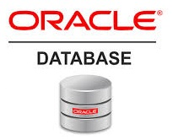
Oracle database
Lecture 32

Slide 2

Today’s Agenda
Introduction To DCL Commands
Understanding Schema
SYS and SYSTEM
Creating New User
Concept Of TableSpace
Unlocking Users
Dropping Users

Slide 3
Introduction To DCL Commands
Oracle protects the data in the database by implementing security via users, roles, and privileges.
The SQL language commands used to accomplish these security tasks are known as Data Control Language (DCL) commands.

Slide 4
Introduction To DCL Commands
There are several different ways to enforce access control in Oracle , to ensure that only authorized users can log in and access the appropriate data.
The 3 most popular ways for ensuring security are:
System Privileges
Object Privileges
Roles

Slide 5
Introduction To DCL Commands
System privileges determine the type of actions the user can perform, such as create tables, drop views, or create other users.
Object privileges avoid any wrongful data modifications to individual tables or columns. The owner of database objects can assign these object privileges that control exactly who can access what objects and to what extent.
System and object privileges can be grouped together into a role.

Slide 6
What Is A Schema ?
A schema is a collection of objects (for example, tables, views, indexes, sequences, triggers, synonyms).
Each schema is owned by a single user account with the same name.
Thus , the two terms schema and user account are often used interchangeably.

Slide 7
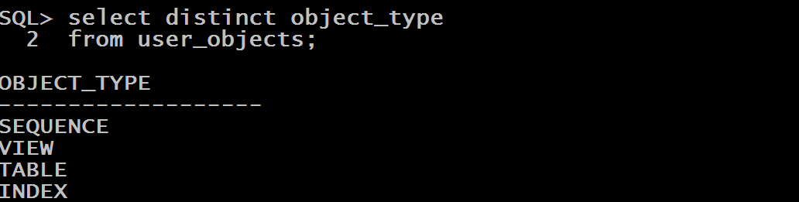
What Is A Schema ?
We can list the types of objects in the ORACLEBATCH schema by querying the USER_OBJECTS data dictionary view.

Slide 8
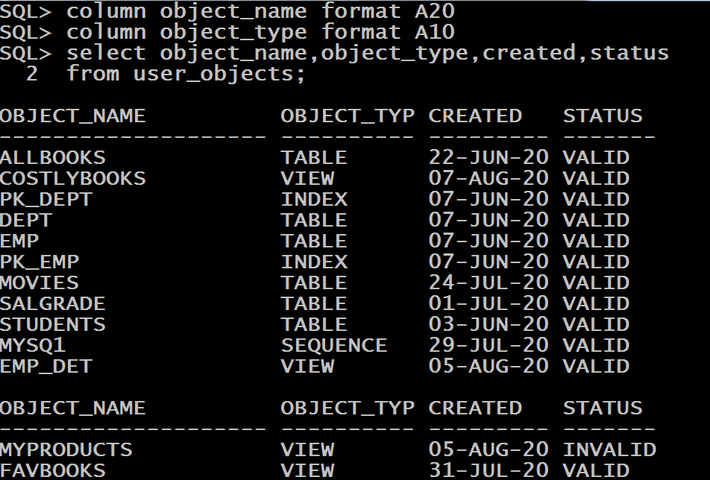
What Is A Schema ?
To get more details on these objects we can further list their name, creation date and status also,

Slide 9
Two Special Users
When an Oracle database is created, it comes with a number of default accounts.
Two extremely important accounts are:
SYS
SYSTEM

Slide 10
Two Special Users
SYS
automatically created when Oracle database is installed
automatically granted the DBA role
has a default password: CHANGE_ON_INSTALL
owns the base tables for the database data dictionary

Slide 11
Two Special Users
SYSTEM
automatically created when Oracle database is installed
automatically granted the DBA role
used to create internal tables and views used by various Oracle database options and tools
We should never use the SYSTEM schema to store tables of our use.

Slide 12
Creating Users
To log in to the Oracle database, a user must have a username, a password, and certain system privileges.
A username is created with the CREATE USER command, whose syntax is mentioned in the next slide.

Slide 13
Creating Users
Syntax:
CREATE USER <user_name>
IDENTIFIED BY <password>;
Example
CREATE USER indians
IDENTIFIED BY intelligent;

Slide 14
Granting TableSpace
The previous command will create a new user called INDIANS with the password intelligent , but we will not be able to create any tables in this user as it has not been assigned any TABLESPACE.
A TABLESPACE in Oracle is a special area in memory where the data of a particular user is saved and the name of this TABLESPACE is USERS

Slide 15
Granting TableSpace
The command to allot access to TABLESPACE USER is:
ALTER USER <user_name>
QUOTA <number> M
On USERS;
Example
ALTER USER indian
QUOTA 100M
On USERS;
The QUOTA 100 M ON USERS clause allows the INDIAN user to use up to 100 MB on the USERS tablespace.

Slide 16
Granting TableSpace
Another way to grant tablespace is as follows:
GRANT UNLIMITED TABLESPACE
TO <user_name>;
Example
GRANT UNLIMITED TABLESPACE
TO INDIAN;

Slide 17
Locked Users
Many times due to wrong login attempts Oracle locks a user or during the database installation process also , Oracle creates some default user accounts that may be locked.
We can use the ALTER USER command with the ACCOUNT UNLOCK option to unlock those accounts.
ALTER USER <user_name> ACCOUNT UNLOCK;

Slide 18
Dropping Users
We use the DROP USER command to drop a user with the following syntax:
Syntax:
DROP USER <user_name> [CASCADE];
Example
DROP USER INDIANS;

Slide 19
Dropping Users
The DROP USER command drops the user if the user does not own any objects.
If we want to also drop the objects owned by the user, we must execute the DROP USER command with the CASCADE keyword.
DROP USER INDIANS CASCADE;

